Slide 1
Student
Managment
System
{
< By Rashid Babazada >
}
...

Slide 2
01
The technologies used in this project are as follows.
{
..
</>
}
..

Slide 3






Back – End and Front - End
}
N - Layer
..

Slide 4
Roles and What They Do
Admin
Cordinator
Crodiator CRUD, Change Semester,
Control of coordinators and so on.
Student, Teacher, Group, Lesson and so on CRUD
Teacher
Student
Writes daily score and attendance, Colloquium, ...
Can view annual student and course information

Slide 5
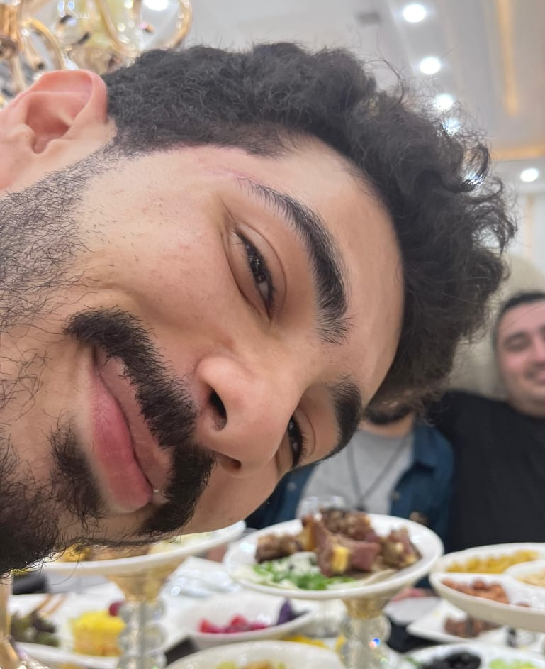
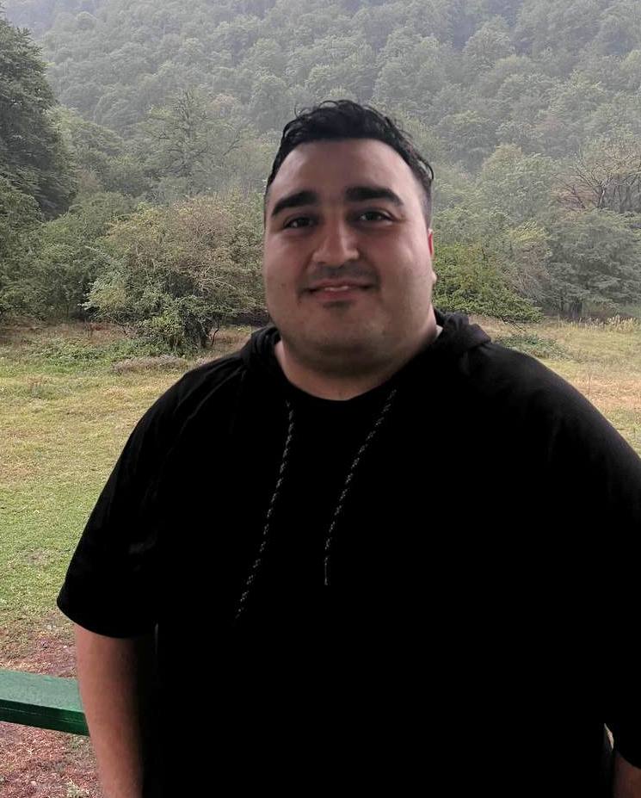
Thank My Teachers!
{
*
..
Yusif Osmanov
Rəsul Rüstəmli
}
..

Slide 6
Thanks for Watchig!
< Do you have any questions? >
Residbabayev42@gmail.com
+994 55 627 22 37

